Slide 1
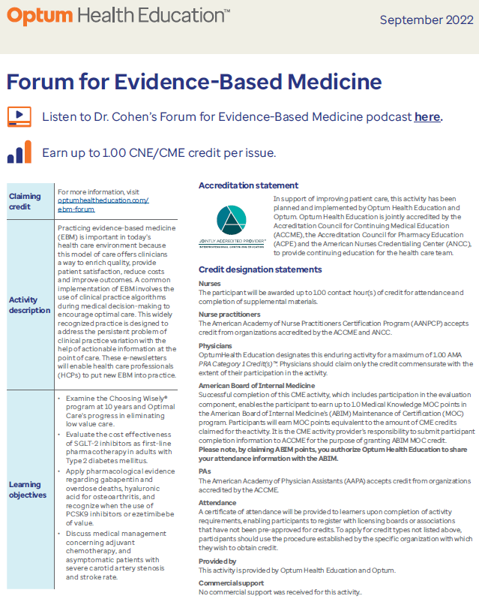
Optimal Care and Palliative Care available on Ignite and the Central Library (fka Xyleme)
Relevant algorithm
Clinician and Patient Handouts
Optimal Care for Cardiology: summary of cardiology specialty module that includes mention of the importance of shared decision-making and consideration of palliative care in the frail elderly prior to scheduling for transcatheter aortic valve replacement (TAVR).
Patient-facing:
Patient and Family Guide – palliative care for caregivers (also available in Spanish)
Patient and Family Guide – advance directives (also available in Spanish)
Early palliative care referral
Forum for Evidence-Based Medicine
January 2023 issue - Cancer treatment in the last month of life

Slide 2
2023 Grand Rounds Topics and Timing
Unlocking patient-reported outcomes to advance quality, experience and decision-making
Active surveillance and management of prostate cancer
Incorporating Palliative Care into Your Primary Care Practice
Pillars of Kidney and Cardiovascular Protective Interventions in Chronic Kidney Disease
Obesity & Diabetes Management: It’s so much more than just a “Magic Pill”
Cancer screening overview of benefits and harms of over and under screening
Every other month starting January, specific dates TBD
Time: 6pm and 8pm Eastern
Registration links for live and on-demand: https://www.optumhealtheducation.com/optimal-care-grand-rounds
Mailing list sign-up: https://www.optumhealtheducation.com/optimal-care-grand-rounds-mailing-list

