Slide 1
Life Milestones Timeline
Trauma Over a Lifetime

Slide 2
Earning CEUs
CEUs are available for the 7 content modules as a series (7 CEUs total)
One pre- and post-series assessment required for the program as a whole
OptumHealth Education saves all CEU credit documentation on their website
https://www.optumhealtheducation.com/
Accreditation opportunities include:
American Medical Association PRA Category 1 Credit™ by the Accreditation Council for Continuing Medical Education
Continuing Nursing Education by the American Nurses Credentialing Center's Commission on Accreditation
Accreditation Council for Pharmacy Education
Pharmacy Tech Certification Board
Case Manager Certification by the Commission of Case Manager Certification
American Board of Social Work Certification and American Psychological Association Certification and National Board for Certified Counselors Certification

Slide 3
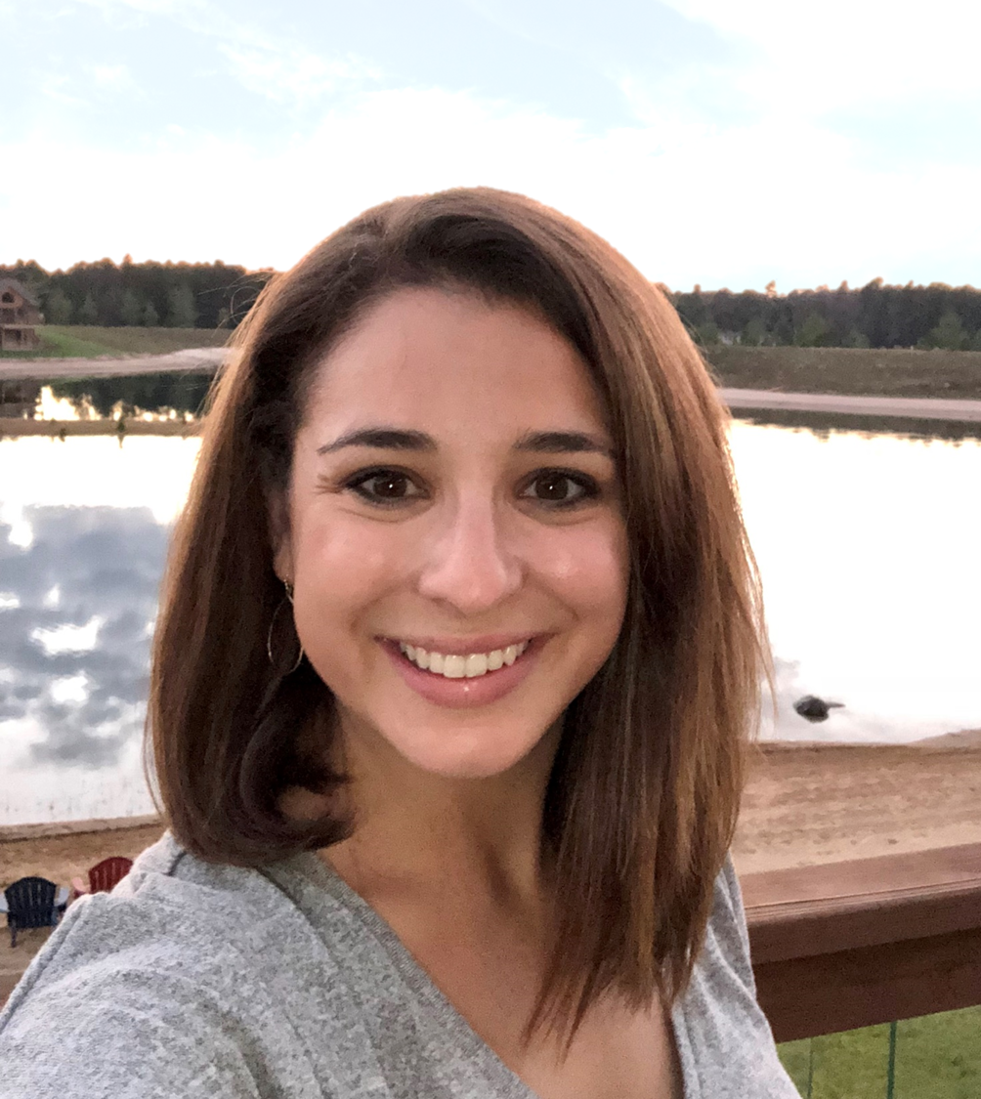
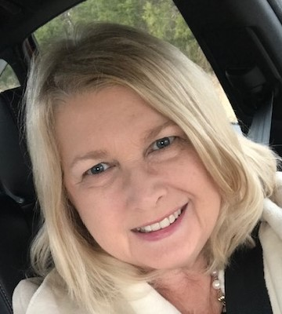
Meet Our Faculty
Kerianne Guth, MSW
Kerianne brings 10 years of experience working with vulnerable and underserved individuals and families. Her work focuses on the translation of trauma-informed clinical care into organization and leadership strategies. She previously served as the Administrative Director for Behavioral Health and Addiction Medicine at Cooper University Health Care in Camden, NJ. There, she co-led the start-up
of the Division of Addiction Medicine that offered medication treatment for substance use disorders, behavioral health support, inpatient consultation, and trauma informed population health initiatives. She was also a founding team member of the Urban Health Institute at Cooper, a dedicated business unit transforming healthcare delivery. Early in her career she worked as a maternal-child health home-visiting social worker after receiving her Master of Social Work degree from the University of Pennsylvania. Kerianne is based outside of Philadelphia with her husband, son, daughter, and two rescue dogs.
Myra Miller, LCSW
Myra Miller is a Licensed Clinical Social Worker with 30 years of experience in the medical and social service fields. She has worked with a diverse population of clients including active military, veterans, adults in an in-patient setting with BH and substance use disorders and out-patient IOP/PHP settings for those with co-morbidities. She maintained a private practice for many years assisting those in a rural
setting with limited access to services, partnering with PCP’s and other specialists. She is past president of the Upper Cumberland Social Service Association and producer/host of “In the meantime ...exploring life’s transitions”, a weekly radio program aimed at building mental health awareness and education. She has performed public speaking engagements to community organizations to improve mental health awareness and resources along with volunteering with local women’s groups to support healthy relationships, self-care and developing talents. She enjoys working with those in the UHC stabilization program and is working on innovative new programs, such as a Telebehavioral health program. Effective communication, conflict resolution skills and mind-body connection education are fundamental elements in developing person-centered, strengths- based goals she uses with clients. Her motto is “Change your mind and your life will follow...”

Slide 4
Check Point
Today’s presentation includes material that may elicit complex feelings for some individuals. Please sign out at any time the material being presented causes you discomfort or distress.
This informational training is an overview of current research and it’s applicability to current practices. Always defer to your business unit’s specific policies. When in doubt, always check with your supervisor.
Employee Assistance Program (EAP)
Available 24/7, EAP provides confidential help when you need it most.
Quick access to experts who can help you with a wide range of well-being and family support services.
www.liveandworkwell.com or 866-781-6396

Slide 5
Learning Objectives
At the end of this course you will be able to:
Define the Life Milestones Timeline.
Identify why mapping trauma over the lifetime is important.
Discuss how to build a Life Milestones Timeline.
Discuss how to use the information gathered from a Life Milestones Timeline.

Slide 6
What is Trauma?
Events or circumstances that are physically or emotionally harmful or life-threatening and that result in adverse effects on the individual’s functioning and well-being.*
Event
TRAUMA
Experience
Effects
*Substance Abuse and Mental Health Services Administration (SAMHSA)

Slide 7
The Life Milestones Timeline
A chronological illustration of significant life events
Labels key times of wellness, loss, change, accomplishments, and other life milestones
Can be as detailed or basic as the person wishes
Flexible in creation – ranging from general to topic-focused

Slide 8
Connection to Care Philosophy and Practice
Trauma-Informed Care
Person-Centered Care
Motivational Interviewing
Personal Narratives
Positive Psychology

Slide 9
Importance of the Life Milestones Timeline
Makes an individual's life experience visible and referenceable
Offers a window into the pivotal moments that shape an individual's thought processes, beliefs, and behaviors.
Gives visual cues and allows recurring themes to emerge across stories
Timeline can be generated over time through natural discussion or more directed conversation and activity
Journal Prompt
You will be asked to complete a Life Milestones Timeline to build empathy for the experience.

Slide 10
Sample Life Milestones Timeline
Rose Dewitt Bukater Calvert “Titanic Survivor”
December 1929 – former fiancée dies by suicide following loss of fortune
1984 Developed arthritis in hands; gives up ceramic art
June 1911 Accepts proposal out of necessity
June 1989 – Husband dies from heart attack
Father leaves family
Mother and Rose lose home and all material possessions to pay off his debts.
April 10-13, 1912
Leaves England for America on Titanic to get married; ends engagement with Cal while traveling
April 14, 1912
Jack died, Titanic sunk
Fakes death – changes name to Dawson – loses touch with mother and former life
1977 Daughter and son in law die in accident; adopts granddaughter; retires officially from acting
1985 Titanic wreckage found

Slide 11
Facilitating the Life Milestones Timeline
Can be completed independently, collaboratively or both
Establish safety before beginning
Determine type of timeline at start of activity
Can be started, stopped, and added to over time
Conversation around activity is valuable
Ensure activity is appropriate for individual and that they're ready

Slide 12
Language During the Life Milestones Timeline
Be empathetic and avoid re-traumatization
Highlight strength and resilience
Sample conversation starters:
“Tell me about a time…”
“Do you remember…?”
“What significant events…?”
Remain focused on the person
Establish safety and respect

Slide 13
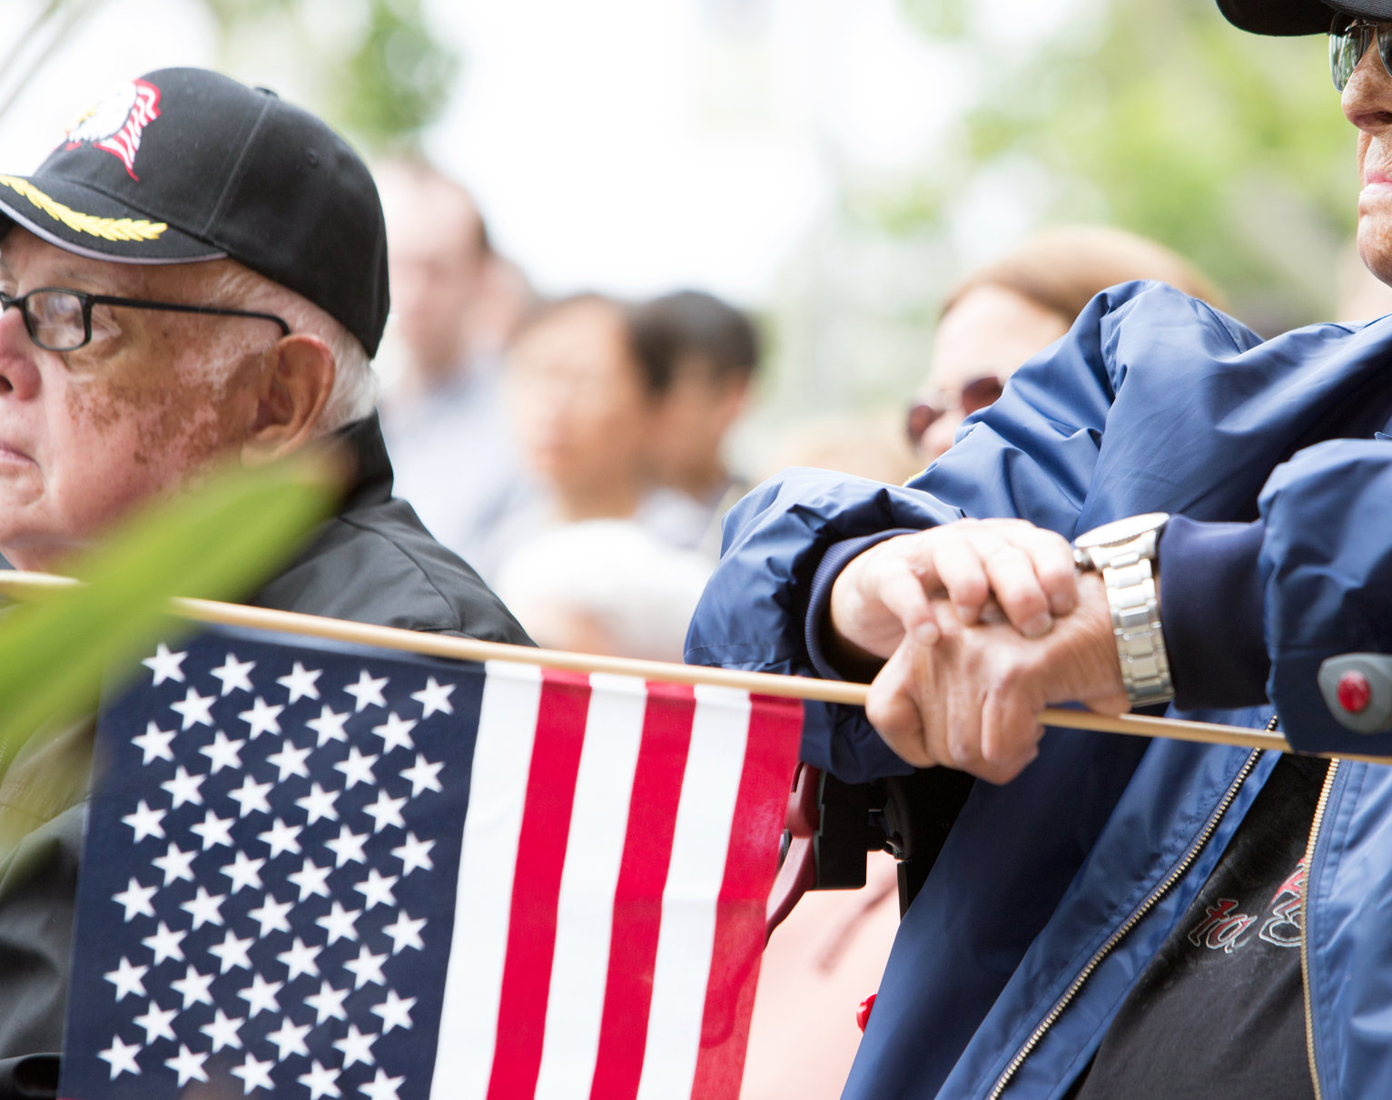
Case Presentation of the Life Milestone Timeline

Slide 14
Vietnam Veteran’s Combat Experience Timeline
Honorable discharge, disabled from hearing loss
2001-2003 street homeless
Children born 1972-1975
1980-1996 works in construction; loses job
Boot camp
Spends 1 year in active combat
Drinking increases
Draft at 18 years old
1967 Deployed as “trained killer”
May 1968- involved in Phase II TET
1980 Divorced; estranged from children
Gets Married
2001- 9/11
Admitted to hospital for heart attack that month
2003
Connects with VA mental health system

Slide 15
How to Use Information on Life Milestones Timeline
No prescriptive actions based on results
Review for patterns and themes
Identify periods of health or positive conditions
Consider pairing with Ecomap, ACE Survey
Inform ongoing care plan

Slide 16
Personal Next Steps
Complete a Life Milestones Timeline for yourself
Use your Personal Journal to reflect on that experience
Reflect on your role and the individuals you or your organization serve. Identify a potential opportunity to introduce this concept and tool to your work.
Journal Prompt
Build your own personal Life Milestones Timeline and identify your personal patterns and themes.

Slide 17
Key Takeaways
1
The Life Milestones Timeline shows the order of events or experiences that may contribute to increases in symptoms.
2
Learn more about a person’s history and who they are as a whole person with space for deeper reflections and relationship.
3
The Life Milestones Timeline can be general or topic-focused over the full life or a specific period of time.
4
Each timeline is unique and culminates in cycles of positive and negatives, highs and lows over the course of a lifetime.

Slide 18
Additional Resources

Slide 19
Additional Development Resources
How to Create a Timeline: The Power of Re-working Your Life’s Story, 1 of 2, By Athena Staik, Ph.D., 2013
The Timeline Exercise: Creating Shifts & Healing Meanings in Your Life Story, Part 2 of 2, By Athena Staik, Ph.D., 2013

Slide 20
Life Milestones Timeline Template (Use this as a template for building a Life Milestones Timeline. Draw events across the provided timeline.)

Slide 21
Learning Circle Guide: Life Milestones Timeline
Directions: In your self-defined Learning Circles, a peer facilitator leads a discussion and/or role-play leveraging the talking points below to process the training content from the most recent learning event. Please reflect on all learning topics to date as you discuss today’s content including personal life experiences and how these topics might be woven into your day to day work with UHG and ultimately impact our members.
Based on what you learned in this session, can you imagine aligning significant life events with current health conditions?
What challenges might get in the way of completing this activity?
For those that are not in direct service delivery roles, can you describe ways that lessons learned in this session can apply to your role/work?
Discuss the possible topic-focused timelines you might engage in with a person you serve and why you selected that topic.
If time permits and volunteers are willing, engage in a role-play where you practice the Life Milestones Timeline. Focus on:
Explanation of the activity
Allowing natural discussion to flow
Look for patterns and themes in identified events

